Slide 1
Inter process Communication Mechanisms

Slide 2
Inter process communication (IPC) is the transfer of data among processes. Some of the examples are
A Web browser may request a Web page from a Web server, which then sends HTML data.This transfer of data usually uses sockets in a telephone-like connection.
one may want to print the filenames in a directory using a command such as ls | lpr. The shell creates an ls process and a separate lpr process, connects two with a pipe, represented by the “|” symbol. A pipe permits one-way communication between two related processes. The ls process writes data into the pipe, and the lpr process reads data from the pipe

Slide 3
IPC Mechanisms
Info copy
Message
Info to be
shared
OS IPC
Mechanism
Address Space for p₀
Address Space for p₁
Sharing of Information can be in
User space
Kernel space

Slide 4
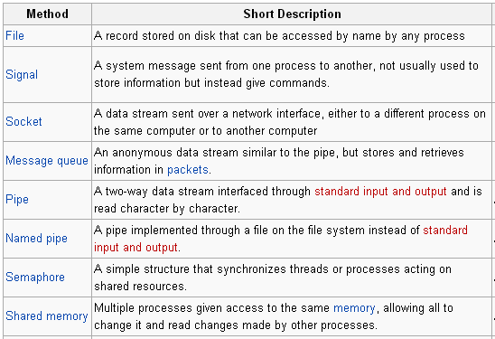
Main IPC methods
allow processes to communicate by sending messages to a queue
Provides communication between unrelated processes, even on different machines.

Slide 5
Signals
Inter process mechanism in Linux system

Slide 6
What is signals
In short: Signals are a way of sending simple messages to processes.
Signals are usually used by the operating system to notify processes that some event occurred, without these processes needing to poll for the event.

Slide 7
Definition : Signals
A signal is an asynchronous event which is delivered to a process.
Asynchronous means that the event can occur at any time
may be unrelated to the execution of the process
e.g. user types ctrl-C, when the system hangs

Slide 8
Linux Signals
A LINUX signal corresponds to an event
It is raised by one process (or OS) to call another process’s attention to an event
It can be caught (or ignored) by the subject process

Slide 9
More on Signals
LINUX has a fixed set of signals
signal.h defines the signals in the OS
Each LINUX signal has an integer number and a symbolic name Defined in <signal.h>

Slide 10

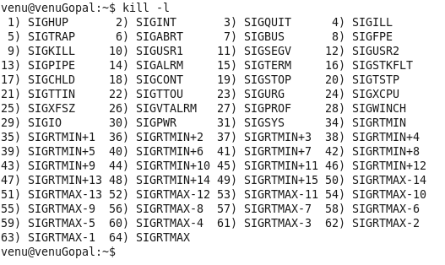
The command ‘kill –l’ lists all the signals that are available.
Notes:
The list of all available signals can be found from kill –l command.
Among the list, some of them are
SIGINT: This signal is generated, when a ctrl+c is given through the keyboard.
SIGSEGV: This is generated when there is some segmentation problem, related to memory
SIGPIPE: if the reading end of a pipe is closed and we are writing at the other write pipe end
SIGCHLD: This signal is sent by the child process to its parent before exiting
SIGSTOP: This signal is generated by ctrl-z

Slide 11
Signals
Most signals have predefined meanings:
SIGHUP (HangUp): when a terminal is closed, the
hangup signal is sent to every process in control terminal.
SIGINT (interrupt): ask politely a process to terminate(ctrl+c)
Used to interrupt running processes from the terminal.
SIGQUIT (quit): ask a process to terminate and produce a
core dump (a file containing the process's memory contents at the time of termination) -> (ctrl+\) forcefully terminate a process and obtain debugging information.
SIGKILL (kill): force a process to terminate.
The most forceful signal. It cannot be caught, blocked, or ignored by the process. It immediately terminates the process

Slide 12
Signal Sources
terminal driver
memory management
shell command
SIGINT
SIGHUP
SIGQUIT
SIGKILL
kernel
SIGPIPE
SIGWINCH
SIGALRM
window manager
a process
SIGUSR1
other user processes

Slide 13
Sending signals to process. (by keyboard)
Ctrl-c
This causes the system to send an INT signal
(SIGINT) to the running process which causes
The process to immediately terminates.
Ctrl-z
This causes the system to send an TSTP signal (SIGTSTP) to the running process this causes The process to Suspend execution.
Ctrl-\
This is same as ctrl-c but with better flexibility
This sends ABRT Signal (SIGABRT)
The default action for SIGABRT is to terminate the process and generate a core dump.

Slide 14
Signal transmission
The mechanics consist of two distinct steps:
Signal Generation: The kernel updates data structure of the destination process to represent that a new signal has been sent
Signal delivery:
Description: Signal delivery is the process of actually causing the destination process to react to the signal. This involves interrupting the normal flow of execution and handling the signal according to the process's specifications
The kernel forces the destination process to react to the signal by changing its execution state, by starting the execution of a specified signal handler.
The signal handler is a function or routine provided by the process to handle the received signal. The kernel initiates the execution of the specified signal handler

Slide 15
It's important to note that not all signals require a signal handler. Some signals have default actions associated with them, and the kernel will perform these default actions if the process has not explicitly set up a signal handler.
Additionally, certain signals, such as SIGKILL, cannot be caught, blocked, or ignored by the process. They result in immediate termination of the process without any opportunity for the process to handle the signal
In summary, signal transmission involves the generation of a signal by one process and the subsequent delivery and handling of that signal by the target process, with the kernel playing a crucial role in coordinating these actions.
When a process wants to respond to a particular signal, it "catches" or handles that signal by registering a signal handler for it. This is typically done using the signal() or sigaction() syscalls in c

Slide 16
Delivering a Signal
Actions performed upon Delivering a Signal
1. Explicitly ignore the signal
2. Execute the default action associated with the signal
3. Catch the signal by invoking a user defined signal handler function

Slide 17
Ignoring the signal
The process can choose to ignore a particular signal explicitly. This means that when the signal is received, the default action associated with that signal is skipped, and the process continues its execution without interruption.
Do_signal() simply continues with a new execution of the loop.
ka= &current->sig->action[signr-1];
If (ka->sa.sa_handler== SIG_IGN )
Continue ;

Slide 18
Default action for the signal
Execute the default action associated with the signal
The important actions are (based on signal type)
Terminate (kill)
Dump (core file for execution context is created)
Ignore (signal is ignored)
Stop (process is stopped).

Slide 19
Pre-defined Signal Handlers
There are two pre-defined signal handler functions that we can use, instead of writing our own:
SIG_IGN: Causes the process to ignore the specified signal. For example, in order to ignore Ctrl-C completely, write this: signal(SIGINT, SIG_IGN);
SIG_DFL: Causes the system to set the default signal handler for the given signal signal(SIGTSTP, SIG_DFL);

Slide 20
Executing the default action for the signal
The signals whose default action is stop may stop all processes in the thread group
The signals whose default action is dump may create a core file in the process working directory.
The default action of terminate is simply killing the process.

Slide 21
Catching the signal
If a handler has been established for the signal, do_signal() function must enforces its execution.
Signal handlers are functions defined by User mode processes and included in the User mode Segment.
Handle_signal() function runs in kernel mode while signal handlers run in user mode.

Slide 22
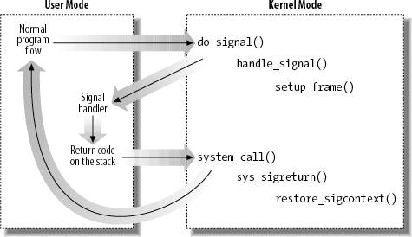
Catching the signal

Slide 23
Signal Handling
Use the signal handling library: signal.h
Then can use the signal call:
#include <signal.h>
void *signal( int sig, void (*handler)(int));
signal returns a pointer to the PREVIOUS signal handler
#include <signal.h>
Signal (SIGINT, handler);

Slide 24
System calls related to signal handling
Kill() - sys call send signals to processes
kill(pid, sig)
#include<sys/types.h>
#include<signal.h>
Int kill (pid_t pid, int sig
//returns 0 on success -1 on fail
Sample programs

Slide 25
Summary
A signal is an asynchronous event which is delivered to a process
Signals are a way of sending simple messages to processes
Various system calls related to signals

